Slide 1
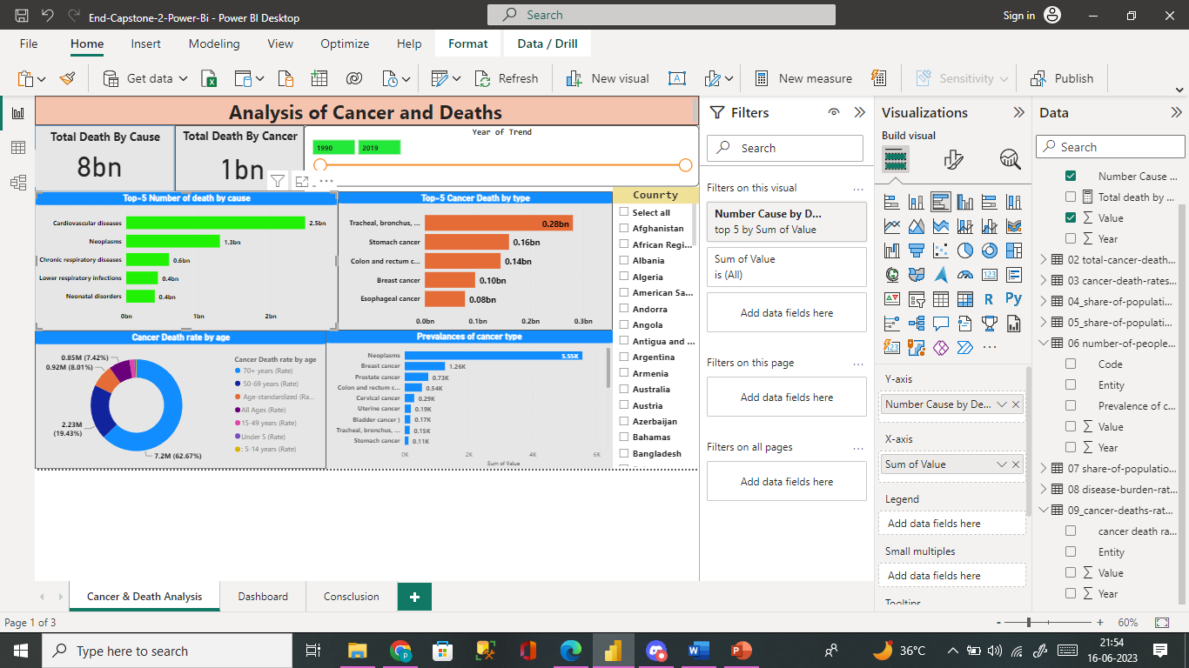
Conclusion from the Analysis:
1. Cluster bar Chart represents the number death causes rates of different types of causes from the year 1990 to 2019, we concluded from the analysis that the top 5 death causes with the most death cancers were Cardiovascular diseases, Neoplasm.

Slide 2
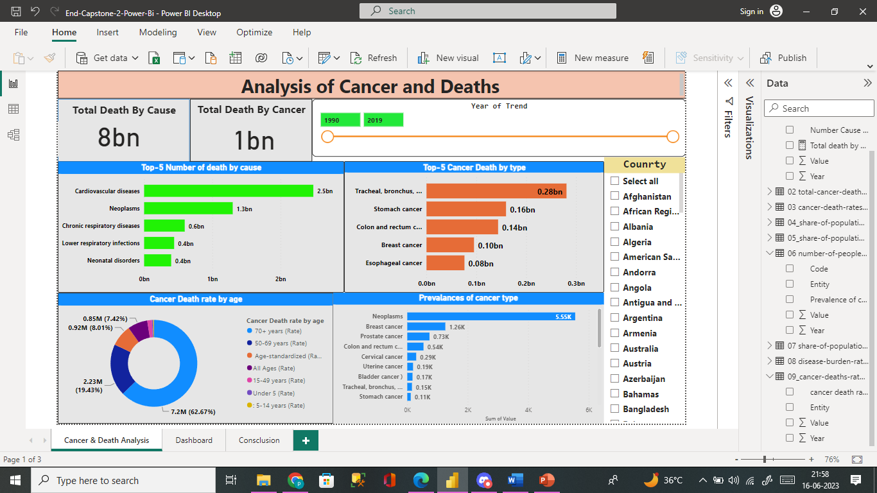
2.Bar Chart represents the death rates of different types of cancers from the year 1990 to 2019, we concluded from the analysis that the top 5 cancers with the most death rates among the other cancers were Tracheal, bronchus, and lung cancer, colon and rectum cancer, stomach cancers. Death rates jumped from 0.28bn for Tracheal, bronchus.

Slide 3
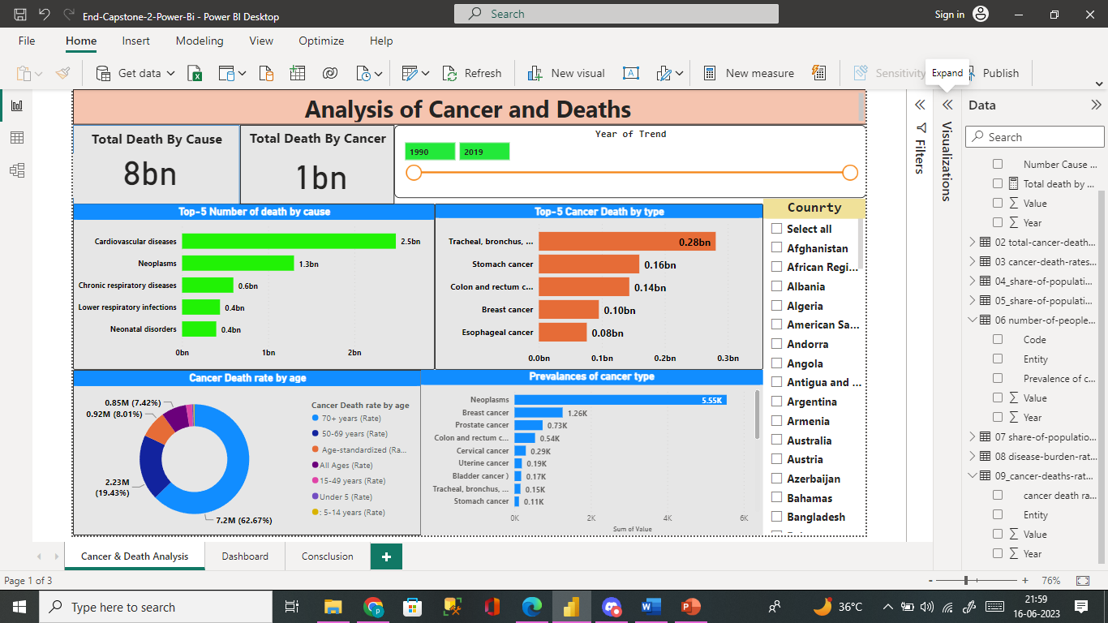
3.Donut Chart shows the deaths from cancer based on the age types: 62.67% of deaths were of people aged 70 and above 23% were people aged 50 and 69 ,a minor portions 2.6% were people aged between 15 to 49.

Slide 4

4. From the second line chart, we can estimate the share of the population with any type of cancer is shown for different countries, one hill- like line making it obvious among the others is non-melanoma skin cancer which is highest among the other types of cancer and observed

Slide 5
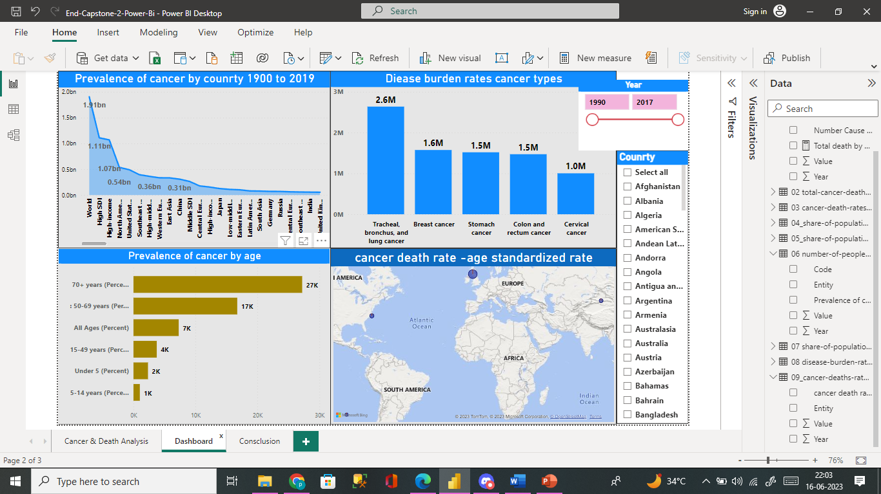
5.from area chart most prevalnaces of cancer in world 1.9bn top and second hoigh incomes countries most surival rates.

Slide 6

6.from area chart prevalanace of cancer by age 50-69 years old and 15-40 years old most surival in world 2004 and 2008 prostate cancer had the best survival rate when compared with other cancers

Slide 7

7.from cluster column chart burden disease cancer types Tracheal,bronchus,and lung cancer ,braest cancer,stomak cancer most dieases rates.

